Slide 1
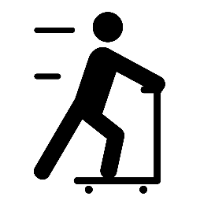
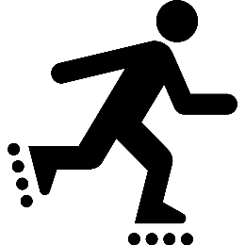
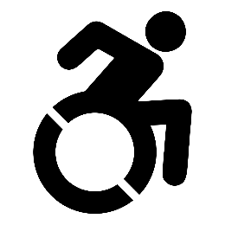
Youth Pedestrian Safety Lessons
DAY 2 – CROSSING SAFELY

Slide 2
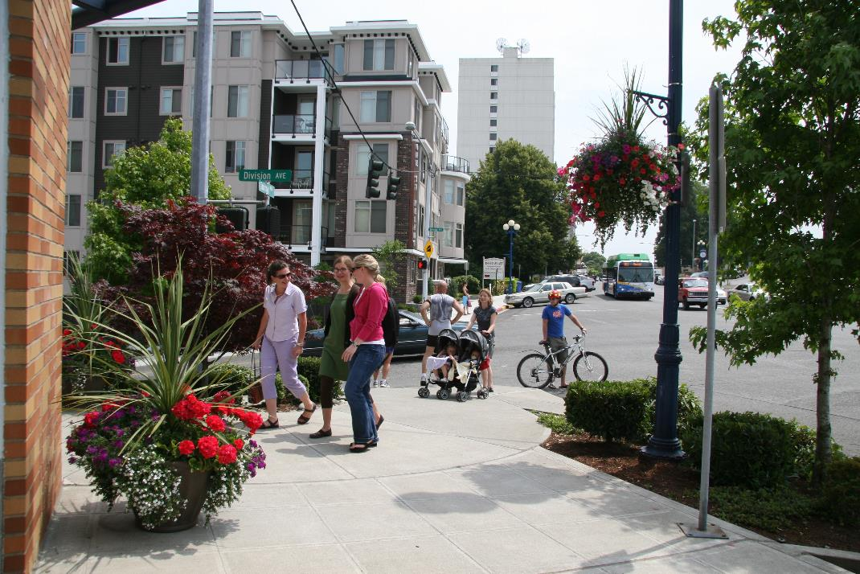
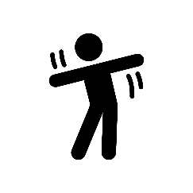
PEDESTRIAN: Someone who walks or moves about using a wheelchair.
ACTION: Walk in place.

Slide 3
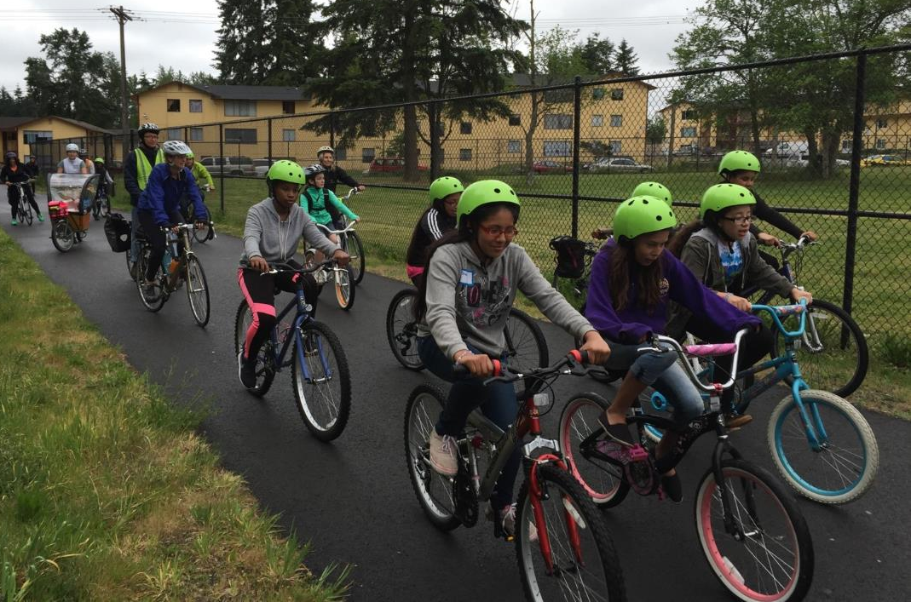
BICYCLIST: Someone who rides a bicycle.
ACTION: Lay on your back and do bicycle crunches OR move your body like you're riding a bike.

Slide 4
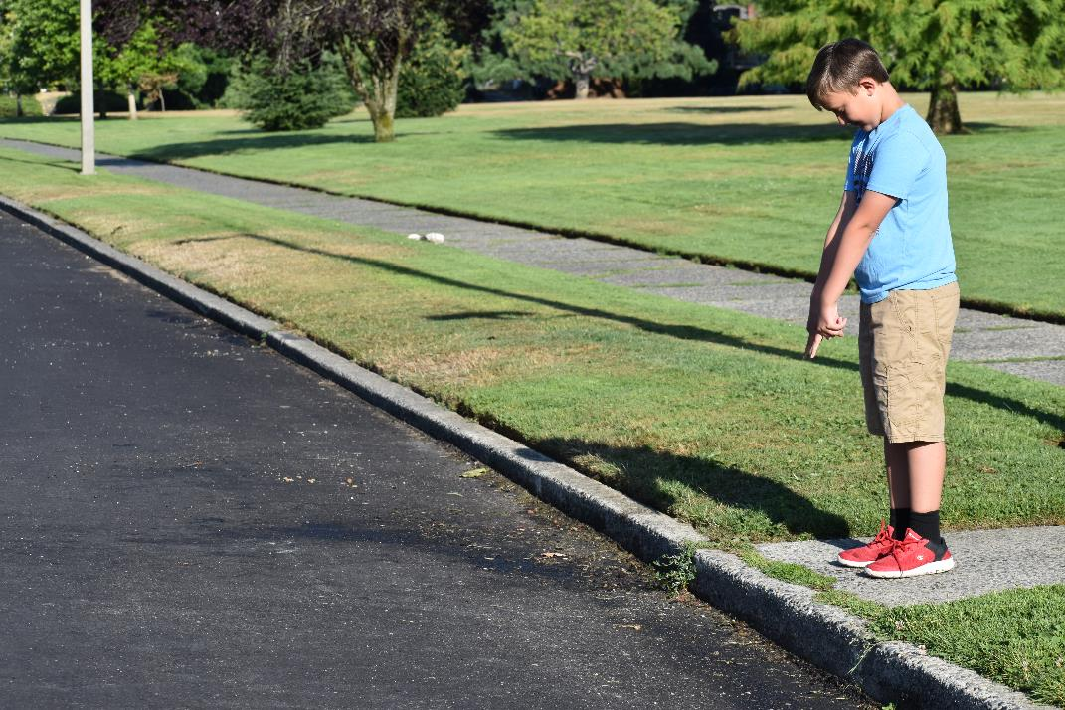
EDGE: A border or outside limit to an area. In this case, where the sidewalk meets the road.
ACTION: Raise your hands above your head, then bend over and point at an imaginary line in front of you. Repeat.

Slide 5
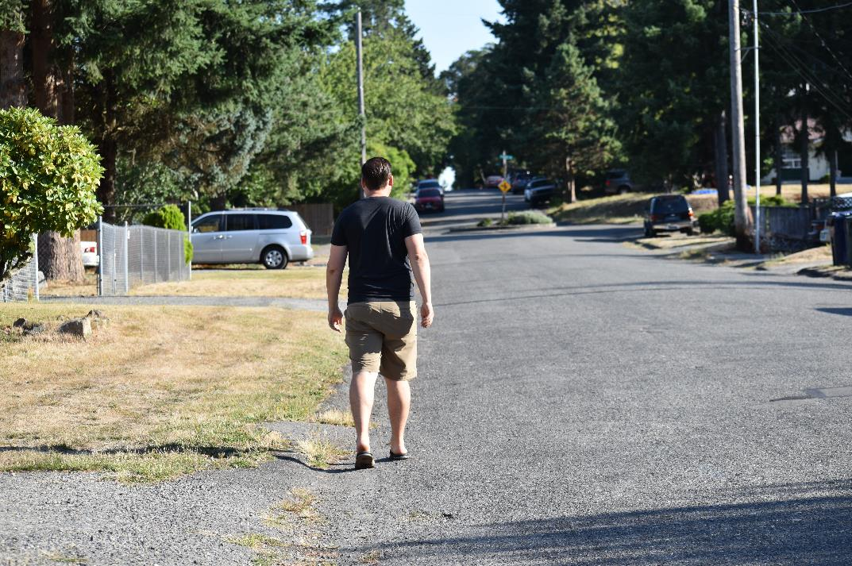
SHOULDER: The edge of the road where cars do not drive. Sometimes a white line separates the shoulder from the road. Cars also sometimes park in the shoulder. The shoulder is used as a sidewalk if there is no sidewalk.
ACTION: Twist your body while brushing each shoulder with the opposite hand.

Slide 6
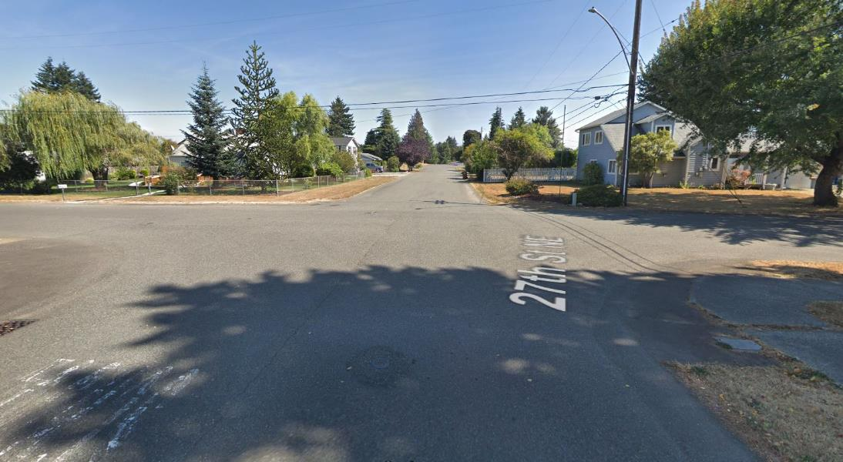
INTERSECTION: A place where two or more streets meet and cross each other.
ACTION: Do five jumping jacks.

Slide 7
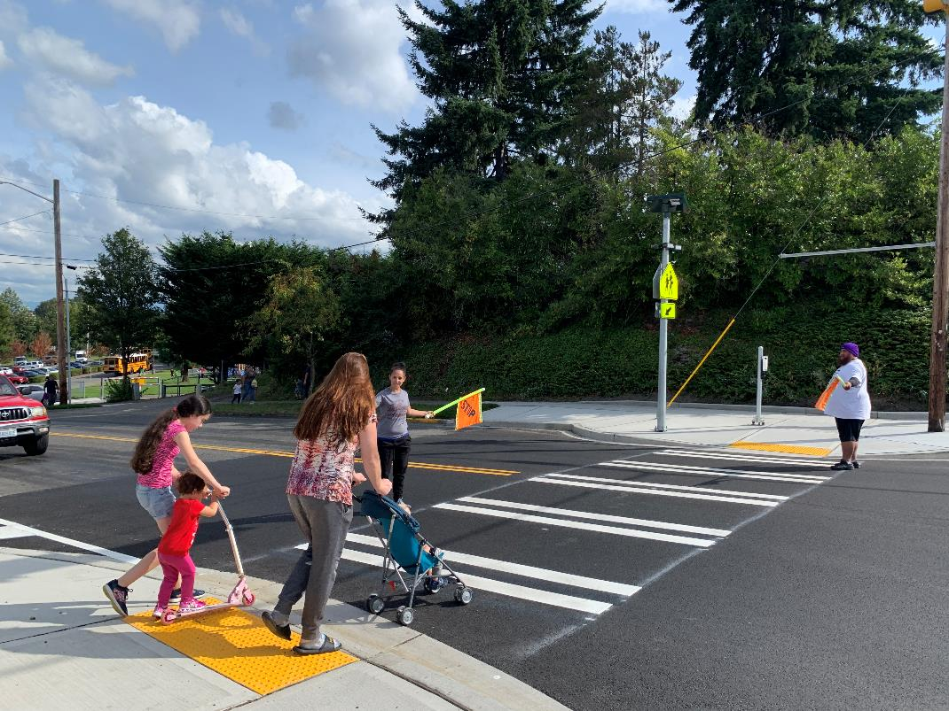
CROSSWALK: Any part of an intersection, either marked with white lines or unmarked, that is for pedestrians to cross the road.
ACTION: Take five steps, then look left-right-left.

Slide 8
Video: Crossing Safely (3:30 min.): https://tinyurl.com/yxryrphn

Slide 9
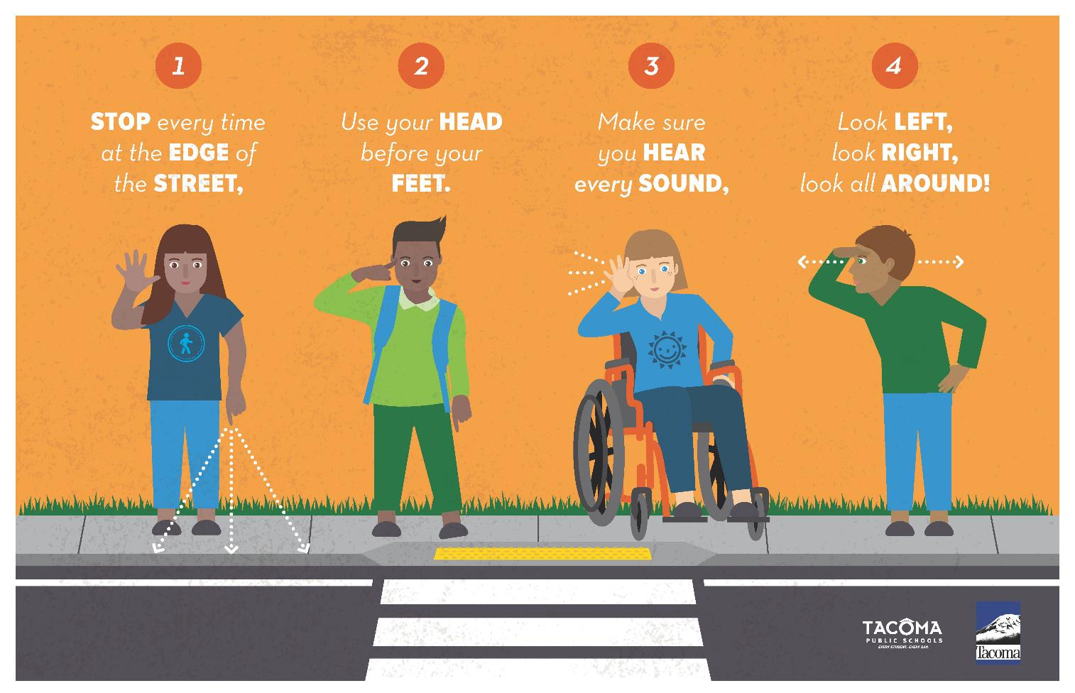

Slide 10
Day 2, Activity 3: Practice Crossing the Street

Slide 12
